Slide 1



Batch No: 17 – Team Spartans
Tech Mentor:-
RAMNATH
Peer Mentor:-
SAMATHA
Members:-
ROHAN KUMAR SHETTY
SACHIN R JANGAMASHETTI
KETHAVATH SAI CHARAN
KARRI SRI SATYA VENKATA KISHORE
SEGU SHANMUKHA SRINIVAS

Slide 2

AGENDA
Introduction​
Technical Stack​
Data Model​
Demo​
Future Scope​
Conclusion​
Requirements

Slide 3
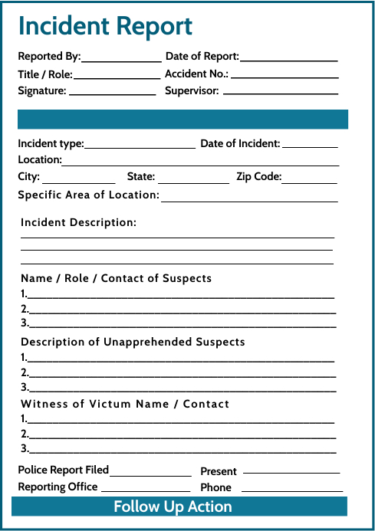
INTRODUCTION
Real-Time Incident Reporting.
Notification Escalation
Data-Driven Decision-Making
Media Attachment.
What we have 😥
What we want 😍

Slide 4


REPORTING AND NOTIFICATION APP
REPORTING AND NOTIFICATION APP

Slide 5
TECH STACK
Front-End : React
Back-End : .NET
Database : PostgreSQL
Development Tools : Visual Studio ,Visual Studio Code, Git

Slide 6
REQUIREMENTS
FUNCTIONAL
User Login and Registration
Incident Reporting
Notification of Designated Safety Officers and Supervisors
Report Generation and Analytic
Media Attachment
2. NON FUNCTIONAL
Reliability
Performance
Usability
Availability

Slide 7
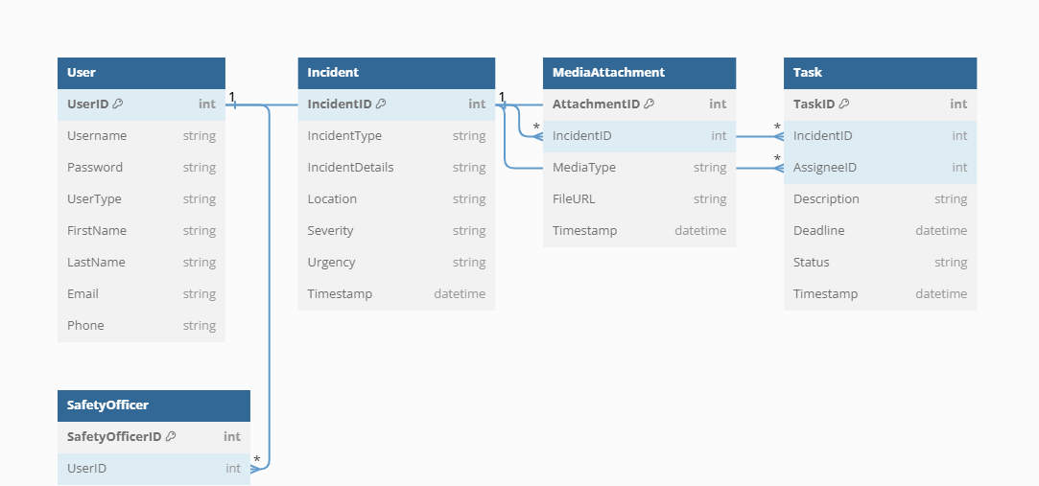
DATA MODEL

Slide 8
DEMO
Suraksha Shell

Slide 9
FUTURE SCOPE
Notification Escalation
Real Time Chat
Mobile App
Predictive analytics
Offline Mode

Slide 10
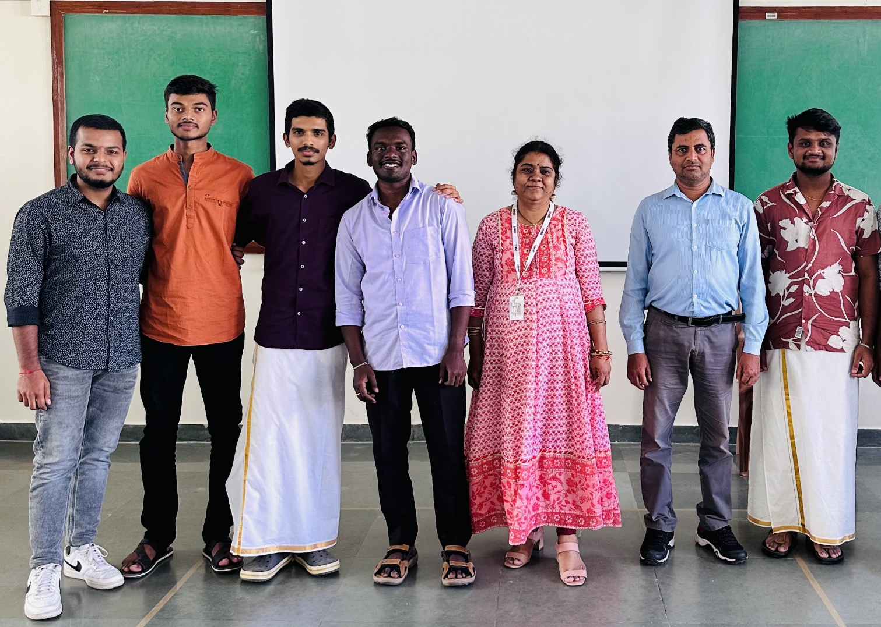
Thank
You........
-TEAM SPARTANS

